Slide 1
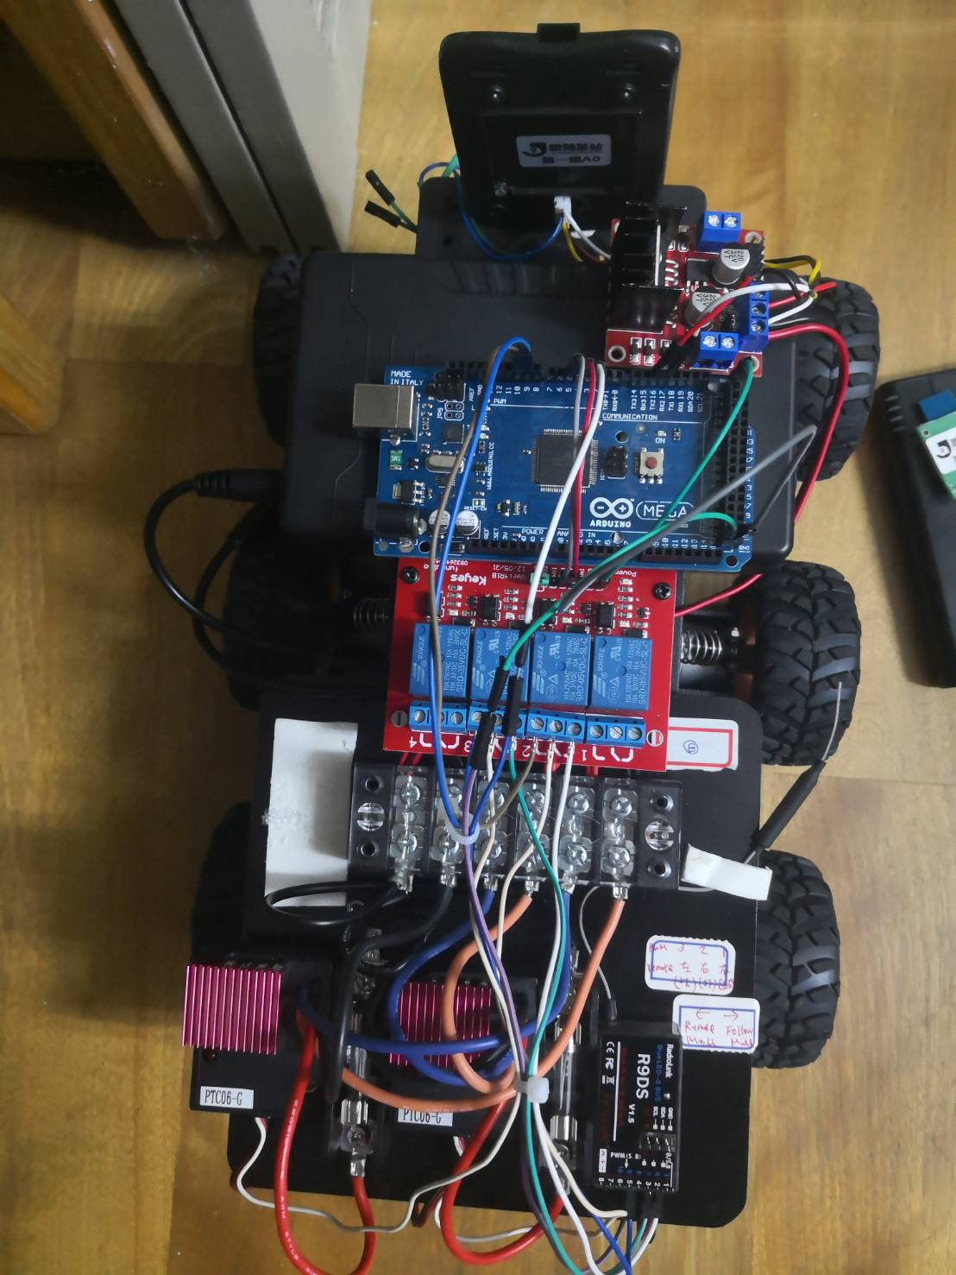
UWB
12V to 5V
Mega2560
Relay
2*6 Terminal
Motor
Driver2
遙控器receiver
Fuse2
Motor
Driver1
Fuse1

Slide 2
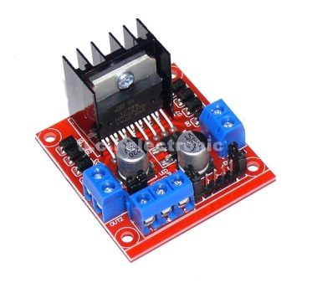
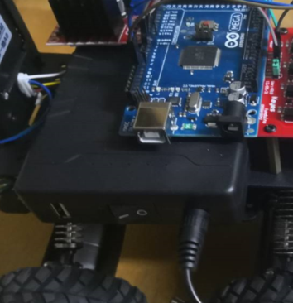
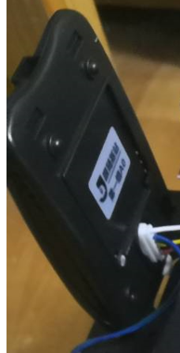
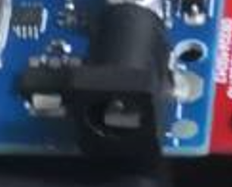
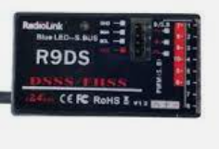
12V
5V
GND
Power 12V
GND
上
CLK
12V
L2980
5V
UWB
Motor Left *3
Motor
Right *3
VIN
VIN
DIO
GND
Gnd
GND
TX
+
-
+
-
RX
TX
RX
12V
12V,GND
5V
下
Mega 2560
DC Jack
TX2
RX2
VIN
GND
OUT1+
OUT1-
OUT2+
OUT2-
2*6 terminal
GND
12V
D2
D4
D9
D5
D10
GND
5V
VOUT
GND
PWMIIN 1
PWM
IN2
PWM
IN3
PWM
IN4
FUSE
IN2
IN1
Relay Board
FUSE
GND
5V
Motor Driver1
Motor Driver2
VIN
GND
PWMOUT
PWMOUT
VIN
GND
PWMOUT
PWMOUT
N.C
COM
N.O
N.C
COM
N.O
VOUT
GND
PWMIN
VOUT
GND
PWMIN
5V
5V
Remoter Receiver
PWM2
GND
VIN
PWM3
GND
VIN
PWM5
GND

